Slide 1
Hollow plastic parts
Polymer Processing, BMEGEPTAGE3
Béla Zink, PhD, assistant professor
2021

Slide 2
Hollow plastic parts
Hollow plastic parts:
One-piece product (not assembled) with a relatively thin wall; open or closed part/product
In the case of open geometry, the opening must not be larger than the cross section.
Size (volume) range 1-2 cm³ … 5(50) m³
Products with any shape can be prepared (spherical, flat)
From a couple of pieces to a couple of million pieces (series)
Process of hollow plastic parts:
Extrusion blow moulding
Injection blow moulding
Rotational moulding
Twin-sheet thermoforming
Gas or water-assisted injection moulding
Lose core injection moulding

Slide 3
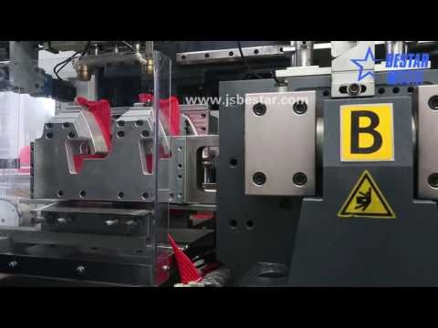
Extrusion blow moulding

Slide 4
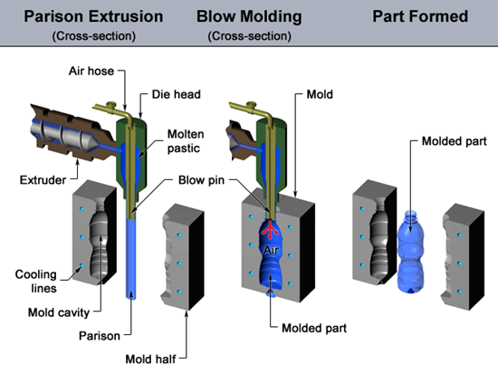
Extrusion blow moulding
Extrusion blow moulding:
https://youtu.be/C2DQ8JudbBE
Forming of the extruded tube (parison) in a closed mould with compressed air to a hollow plastic part/product.
Major steps: parison production with a single screw extruder; blowing of the parison in the closed mould, cooling and ejection; flash removal.

Slide 5
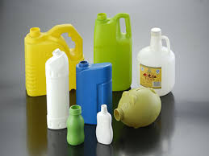
Extrusion blow moulding
Parameters of tube extrusion to be considered :
High melt strength of the selected polymer (and/or lower melt temperature): if it is lower, the tube will not carry its own weight, if it is higher, the parison cannot be formed
No weld lines on the parison (die design)
Uniform flow profile, uniform wall thickness
(along the circumference of the parison). During
shaping the melt in the die: shear and elongational
deformation – molecular orientation – relaxation
and swelling will occur (die design).
Uniform tube temperature: a warmer region will
deform more than a colder region
The weight of the parison will load the parison
itself – stretching – decreasing wall thickness.
Complexity of the product’s geometry (no sharp edges,
no big flat surfaces, max blowing index is 4:1,
wall thickness and volume relationship)

Slide 6
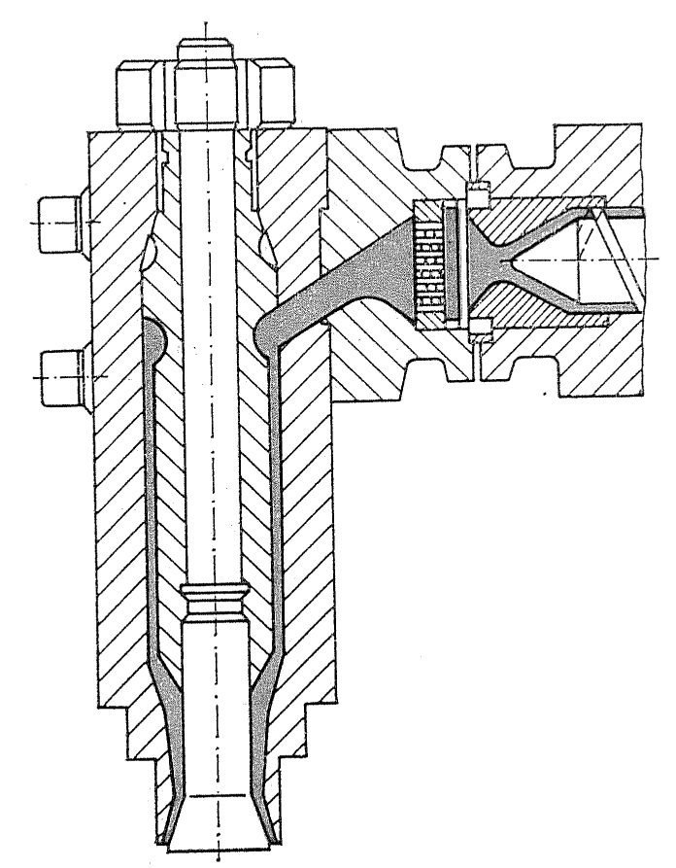
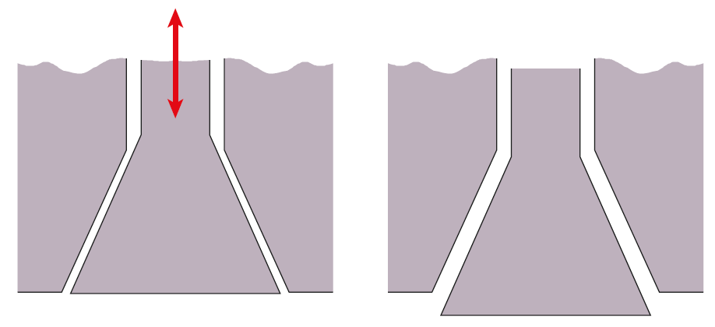
Extrusion blow moulding
Due to different phenomena, changing the wall thickness along the length is recommended:
To vary the screw speed (output)
To move the mandrel of the die up and down, thereby decreasing and increasing the size of the gap.
with without

Slide 7
Extrusion blow moulding
Extrusion blow moulding can be:
Continuous
Discontinuous or intermitted
Blow mould: usually made of Al; pressure is typically in the range of 0.4…0.8 MPa

Slide 8
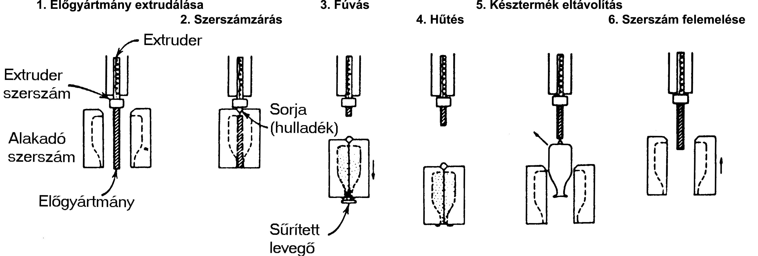
Extrusion blow moulding
Continuous blowing: a product with a small or medium volume in large-scale production. Short cycle time.
Max 1 l product size - mold lifting
Over 1 l product size – parision transfer
Mold lifting with continuous extrusion of the parison
1.Extrusion of parison
3. Blowing
5. Ejection of part
2. Mold closing
4. Cooling
6. Raising of mold
Extruder
Extruder die
Flash
Blow mold
Parison
Pressurised air

Slide 9
Extrusion blow moulding
Mould shuttle with continuous extrusion of the parison

Slide 10
Extrusion blow moulding
Vertical rotary wheel system with continuous extrusion of the parison

Slide 11
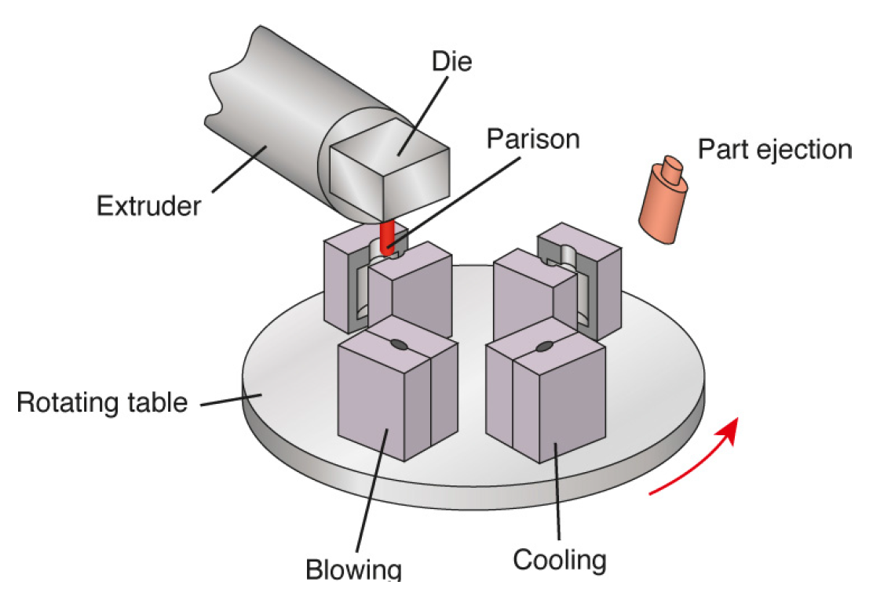
Extrusion blow moulding
Blow molder with a rotating table

Slide 12
Extrusion blow moulding
Parison transfer system with continuous extrusion of parison

Slide 13
Extrusion blow moulding
Discontinuous or intermitted: for products with a larger volume (>5 l). Accumulator is used for storing the polymer melt. It is not suitable for heat-sensitive polymers
Mandrel for thickness adjustment
Hidraulic slave cylinder
Ring piston
Melt from extruder
Moving moldhalf
Programmed insert
Parison

Slide 14
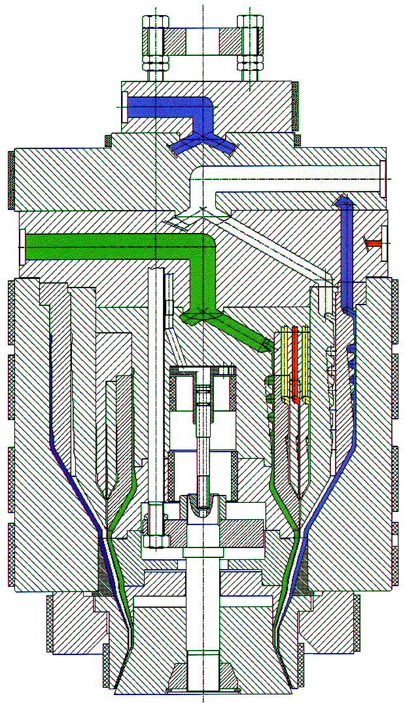
Extrusion blow moulding
Coextrusion die for parison-extrusion
e.g. PP, HDPE+EVOH (Ethylene-vinyl alcohol)
Low gas permeability
Bottle wall thickness
PP or HDPE
EVOH
Path of gas molecule

Slide 15
Extrusion blow moulding
Recommended training videos (Paulson Training):
https://www.youtube.com/watch?v=oY7hyuMHm68&list=PLpL9tJRpo7WVrz7Ulb4PAjxrzkre84vQ6&index=1
https://www.youtube.com/watch?v=nSHOMBmpEyE&list=PLpL9tJRpo7WVrz7Ulb4PAjxrzkre84vQ6&index=2
https://www.youtube.com/watch?v=YWzaZYHXS9s&list=PLpL9tJRpo7WVrz7Ulb4PAjxrzkre84vQ6&index=3
https://www.youtube.com/watch?v=RDV6NXQ_7Rk&list=PLpL9tJRpo7WVrz7Ulb4PAjxrzkre84vQ6&index=6

Slide 16
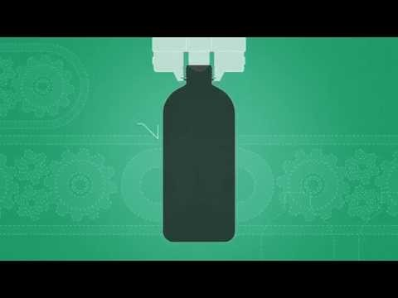
Injection blow moulding

Slide 17
Injection blow moulding
https://youtu.be/pN-MWbcE_vM
Injection blow moulding:
The preform is produced by injection moulding, then the preform is blown in a closed mould
There is no flash (no waste), no welding line
Lower melt-strength materials can be processed (e.g. PS, PET)
Rotationally symmetric and oval products can be manufactured
Accurate wall thickness distribution, precious neck region
Crystallization can be controlled, so transparent products can be made
Max blowing index 3:1, ideal preform L/D 10:1, ideal preform wall thickness 2-5 mm
Major techniques:
Injection moulding and blowing on the same machine
Injection moulding and blow moulding on separate machines
+ Injection stretch blow moulding for both techniques above

Slide 18
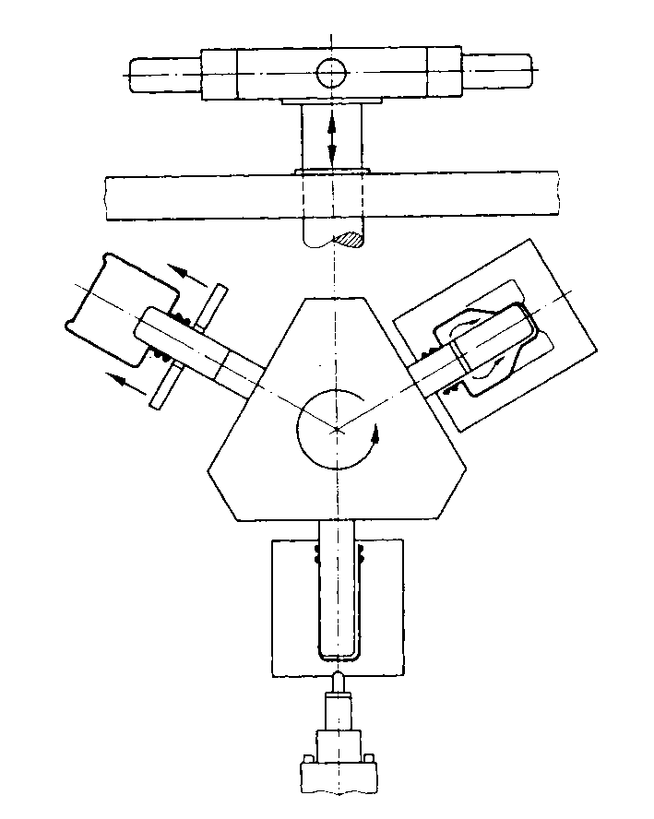
Injection blow moulding
Injection moulding and blowing on the same machine

Slide 19
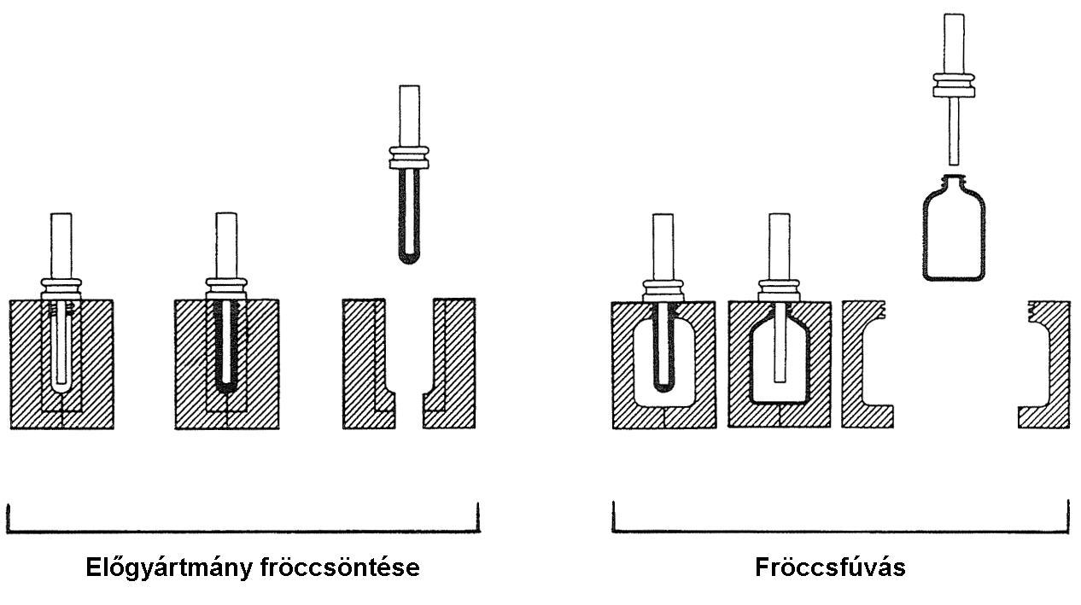
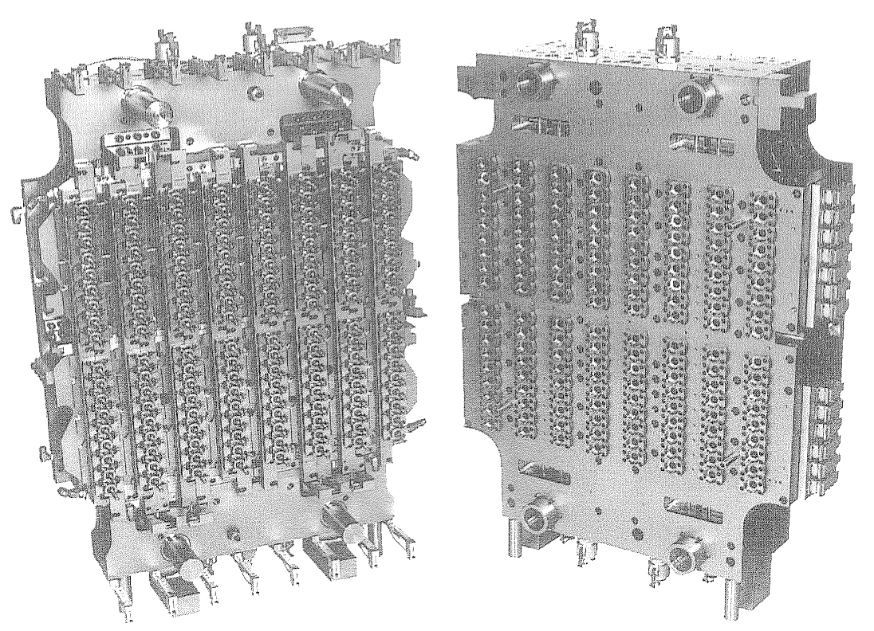
Injection blow moulding
Injection moulding and blow moulding on separate machines
IM of preform Blowing of preform

Slide 20
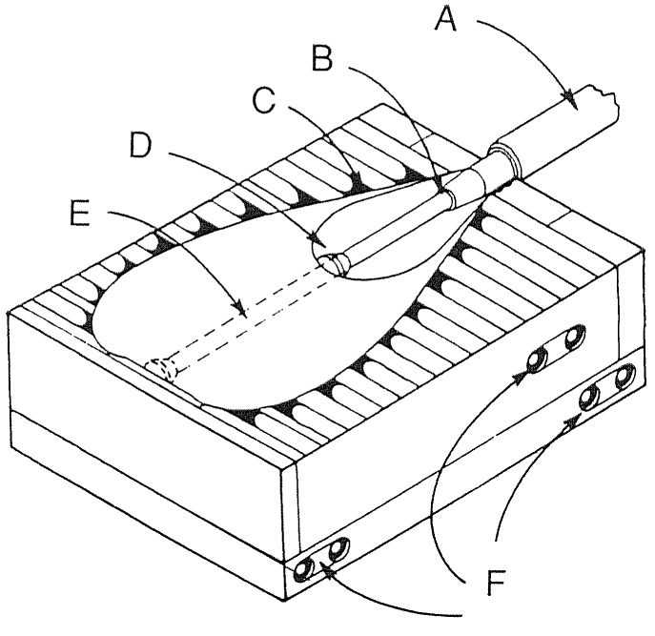
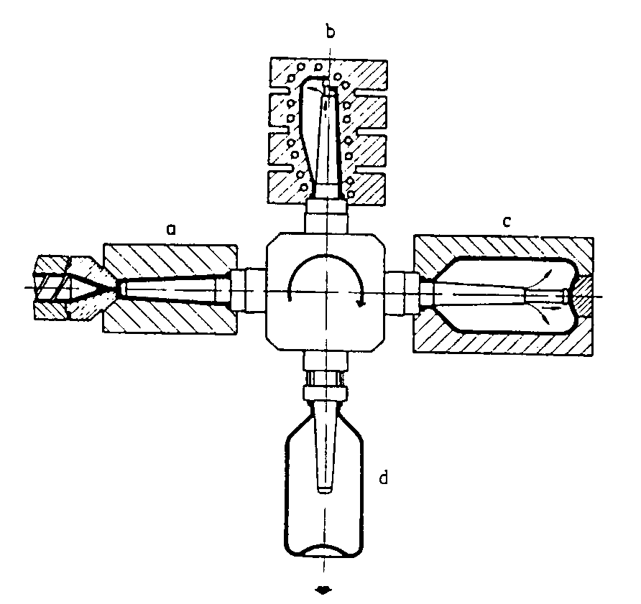
Injection blow moulding
Injection stretch blow moulding
https://www.youtube.com/watch?v=NE4c1gwzPb4
Biaxial stretching -> higher orientation -> higher mechanical strength
e.g. PET bottles: 3.8 circumferential and 2.8 longitudinal stretching -> 200 MPa and 100 MPa tensile strength respectively

Slide 21
Injection blow moulding
Injection stretch blow moulding:
For polyethylene terephthalate (PET) bottles
Goal of stretching: biaxial stretching, orientation
Molecular orientation improves mechanical properties (weaker, cheaper material OR smaller wall thickness is enough), gas permeability, gloss and transparency, dimensional accuracy.
PET – semi crystalline – how can it remain transparent?
Injection molding: low injection speed -> no stress induced crystallization
Blow molding with stretching: preheating to 100 °C (T_{g}<T_{material}<T_{melt})
only small crystals can form (no spherulite )
no refraction for smaller crystals than the wavelength of the visible light

Slide 22
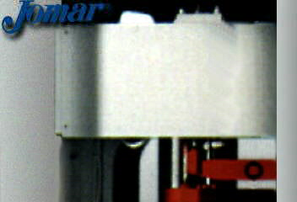
Injection blow moulding

Slide 23
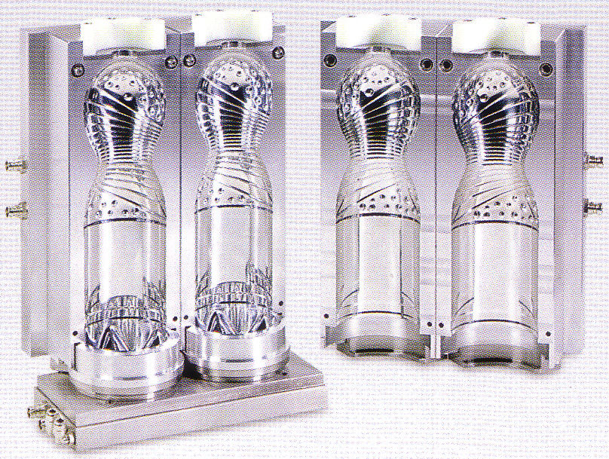
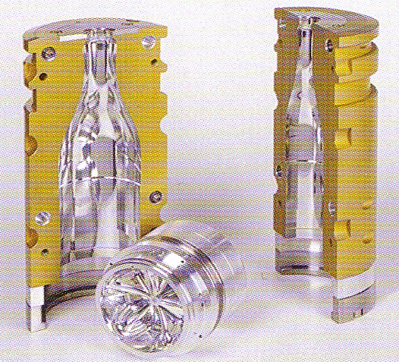
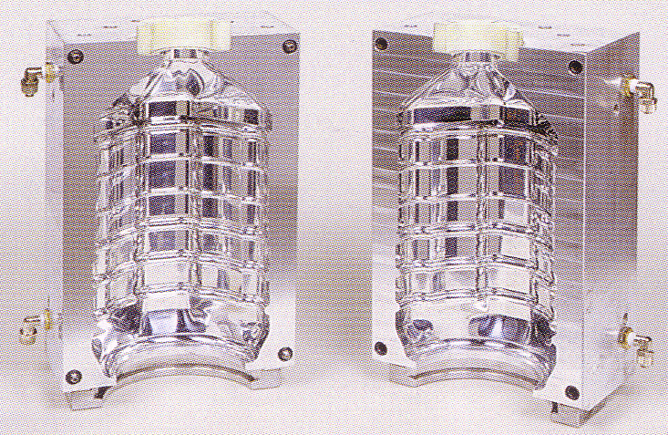
Injection blow moulding
Blow moulds:
https://www.youtube.com/watch?v=ZfyPCujUPms

Slide 24
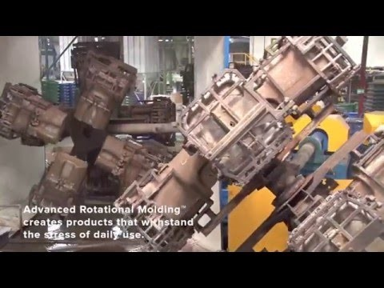
Rotational moulding

Slide 25
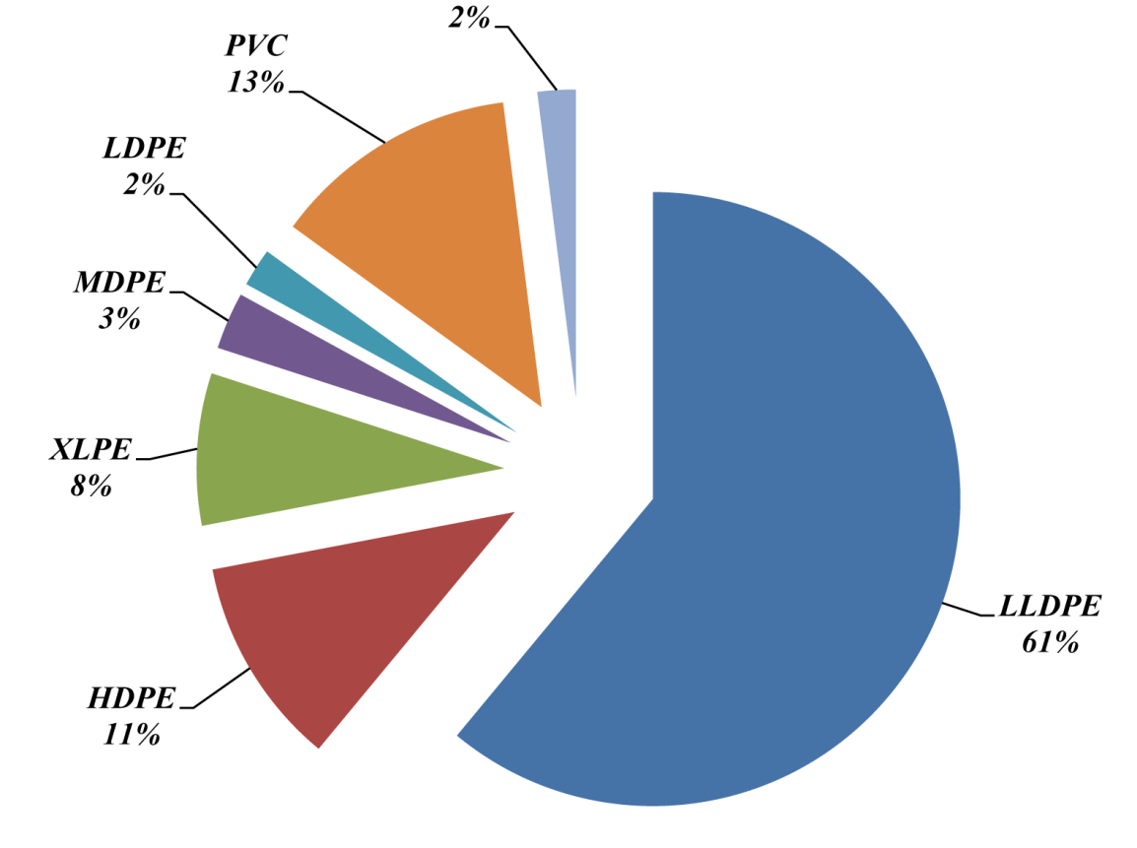
Rotational moulding
Rotational moulding:
  https://www.youtube.com/watch?v=ZWvhvTXEUQ4
Biaxially rotating closed moulds
For preparing large products (1…10 m³)
There is no seam (weld line) no residual stress
Generally used materials:
  LLDPE, LDPE, HDPE
  PVC (powder, fluid)
  PP, rPP
  PA6
  PC
  Recommended videos:
  https://www.youtube.com/watch?v=ckN8Ot6lWRE
  https://www.youtube.com/watch?v=-d_cyeFXJWk&list=TLPQMDIxMTIwMjA1ZRpDXFpFlQ&index=3
  https://www.youtube.com/watch?v=lAQYfJAuw5M
  Other materials

Slide 26
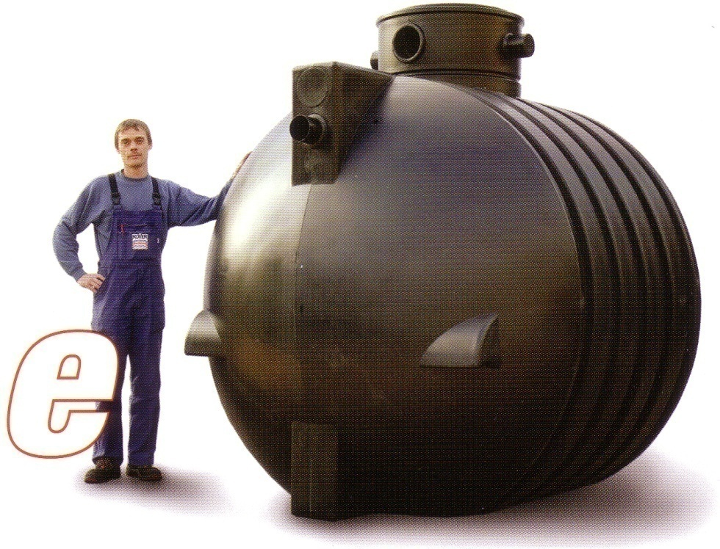
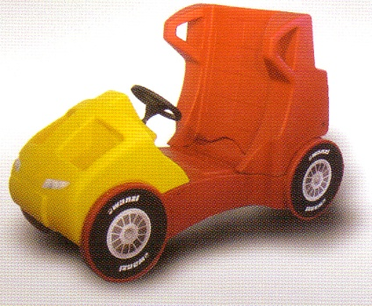
Rotational moulding
Requirements for the materials of rotational moulding
Powder (75…500 µm), ground material, viscous fluid, monomer, oligomer
Thermal stability
Particle size distribution (more even)
Sinterability of the particles
Properly high melt strength

Slide 27
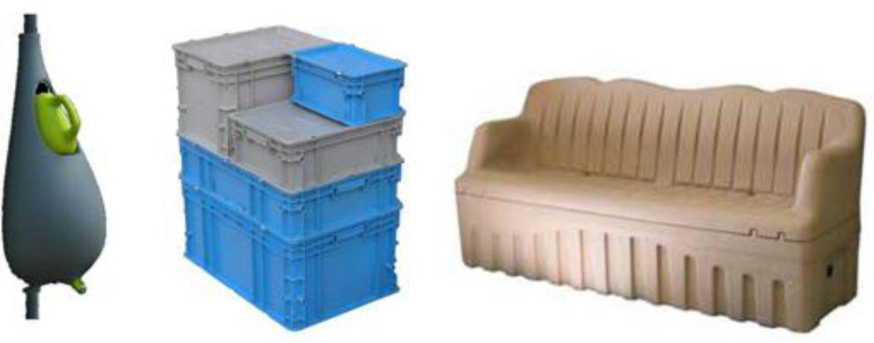
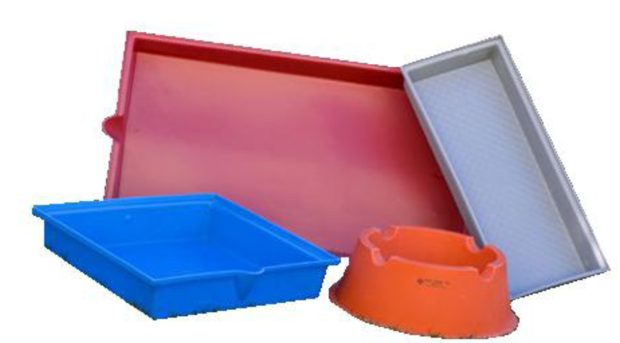
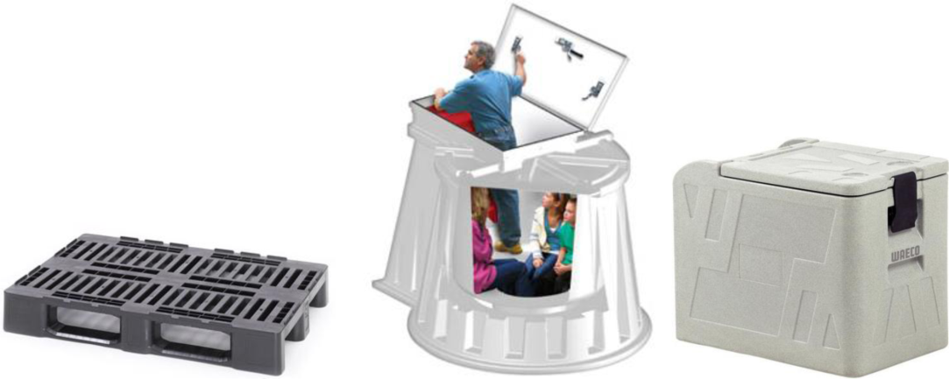
Rotational moulding
Examples:
LLDPE
LDPE
HDPE

Slide 28
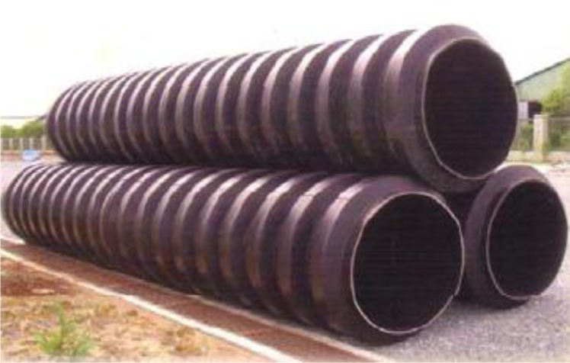
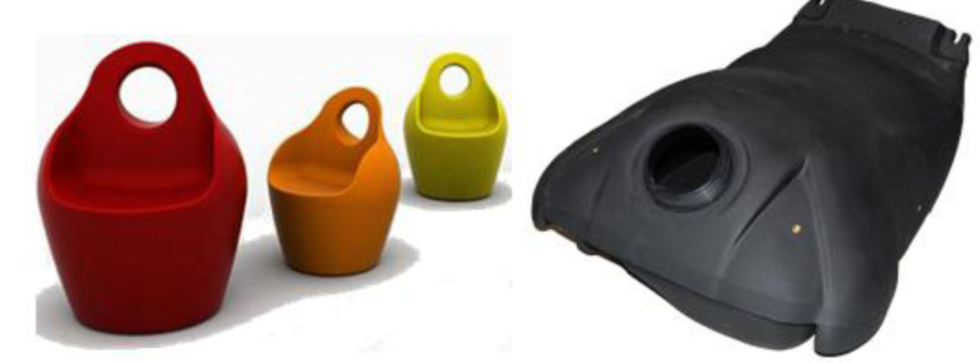

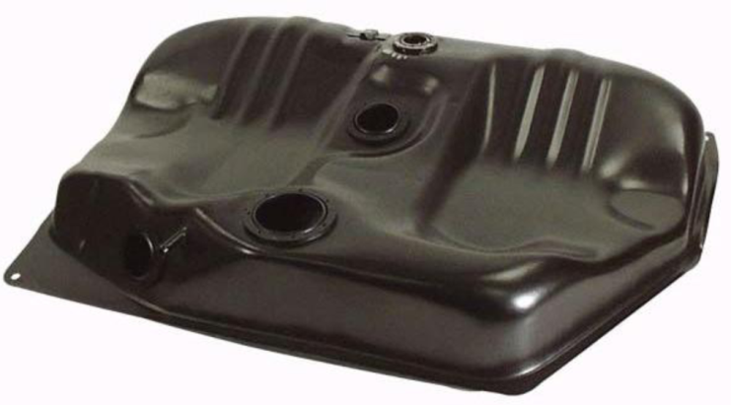
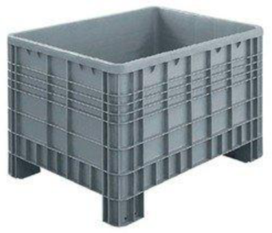
Rotational moulding
Examples:
XLPE
PP
PVC
PA
PC

Slide 29
Rotational moulding
Principle:

Slide 30
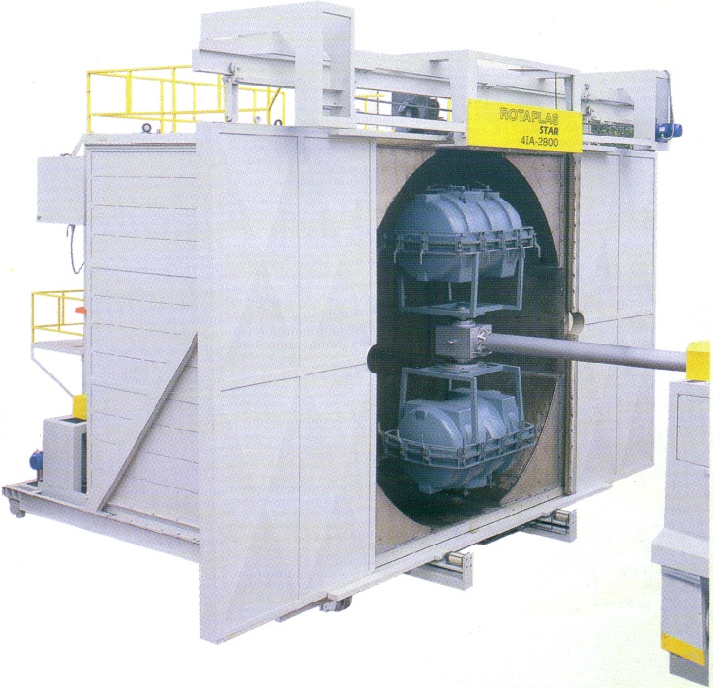
Rotational moulding
Biaxial rotation
Both in heating and cooling phases
Simultaneous rotation of both axes
Different rotational speed of the axes (the speed of the main axis is higher)
RPMs of the axes have to be different and must not be an integer multiple of each other (correct: 3.75:1)
Low revolution speed (˂30 rpm), mostly 3-10 rpm

Slide 31
Rotational moulding
Process of the rotational moulding - heating

Slide 32
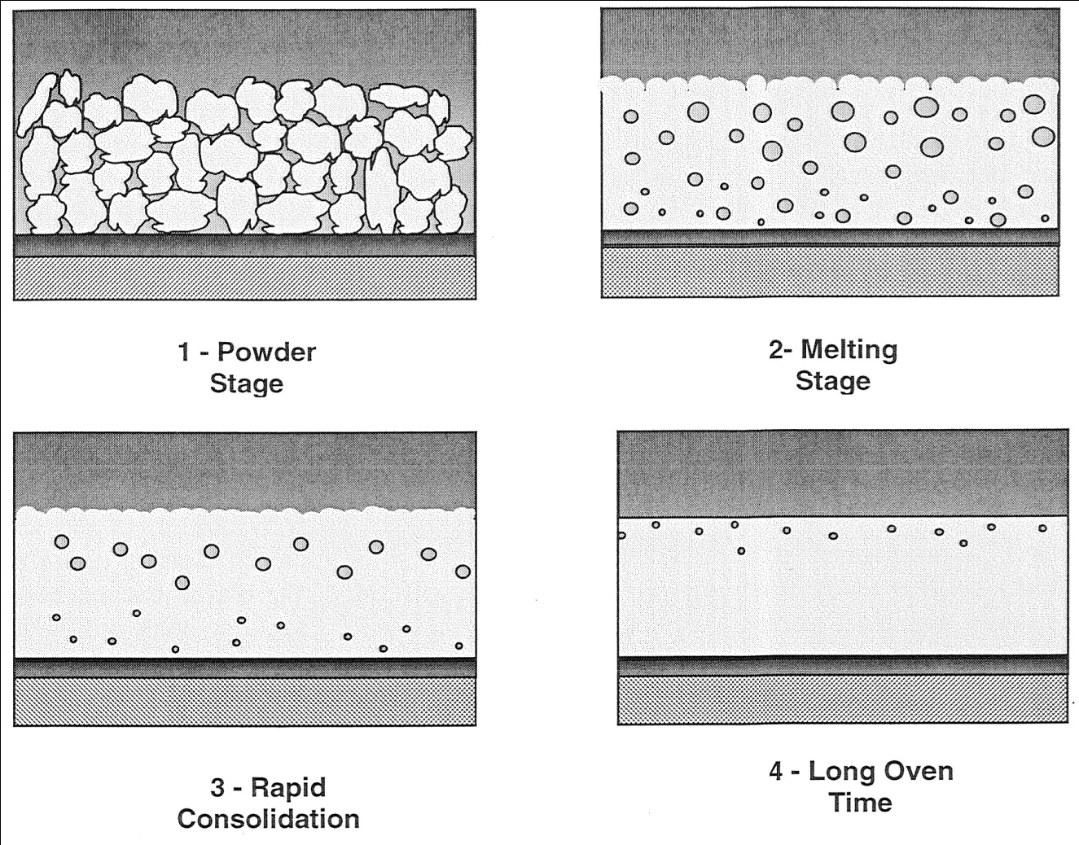
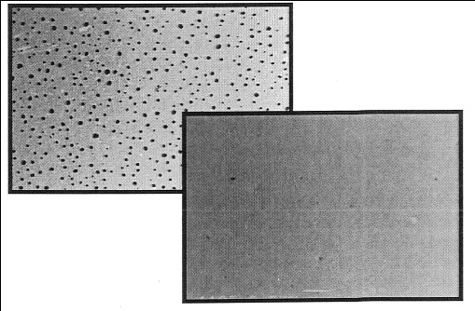
Rotational moulding
Process of rotational moulding - heating

Slide 33
Rotational moulding
Heating methods:
Hot air
Direct flame (gas combustion)
Molten salt
Steam
Infrared
Microwave
Hot water/oil

Slide 34
Rotational moulding
Cooling
Mainly with cold air or water spray
The moulds are kept rotating biaxially
Depends on the materials (heat capacity)
Cooling time is proportional to the square of wall thickness
Shrinkage has to be considered
Removing the product is done manually
Followed by cutting, drilling, etc.

Slide 35
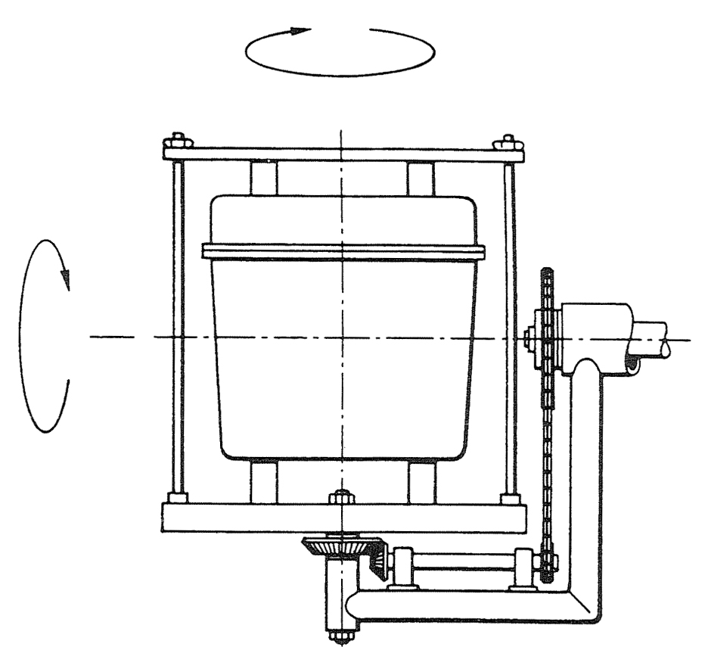
Rotational moulding
Technological setup

Slide 36
Rotational moulding
‚Rock and roll’ setup

Slide 37
Rotational moulding
‚Clamshell’ setup

Slide 38
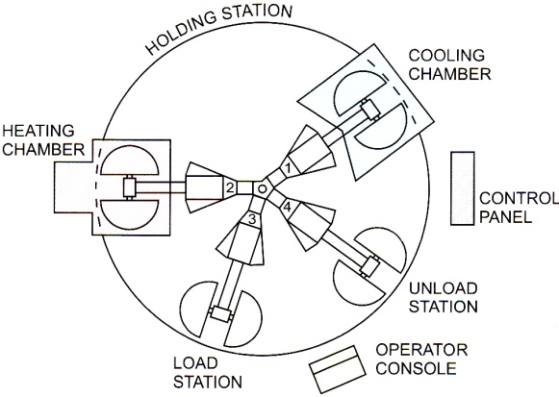
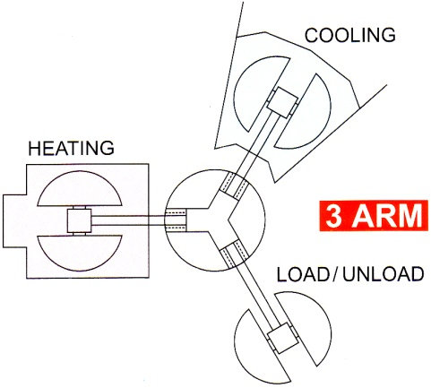
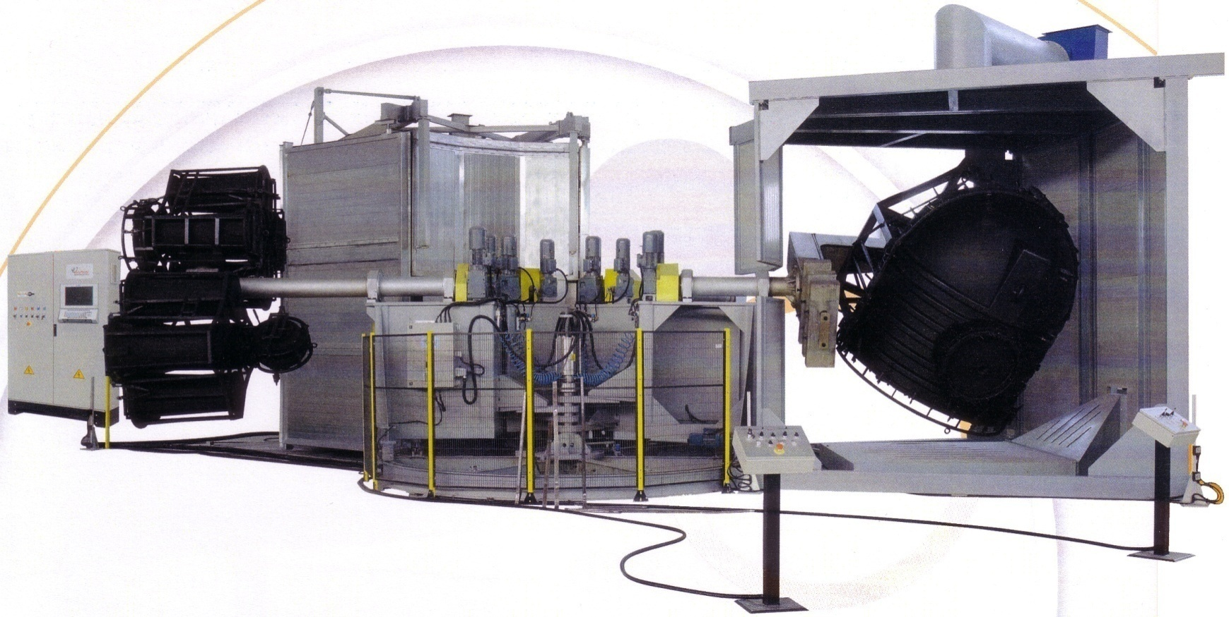
Rotational moulding
Common arrangement of rotational moulding

Slide 39

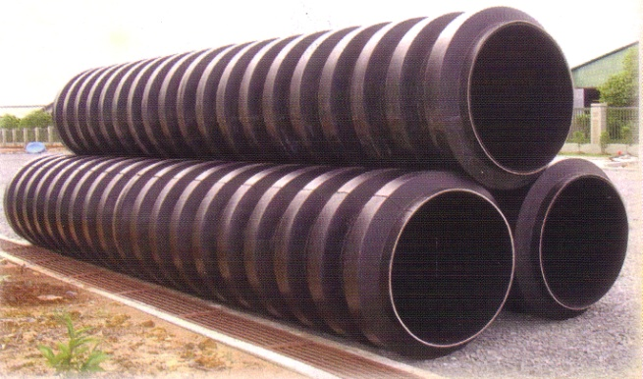
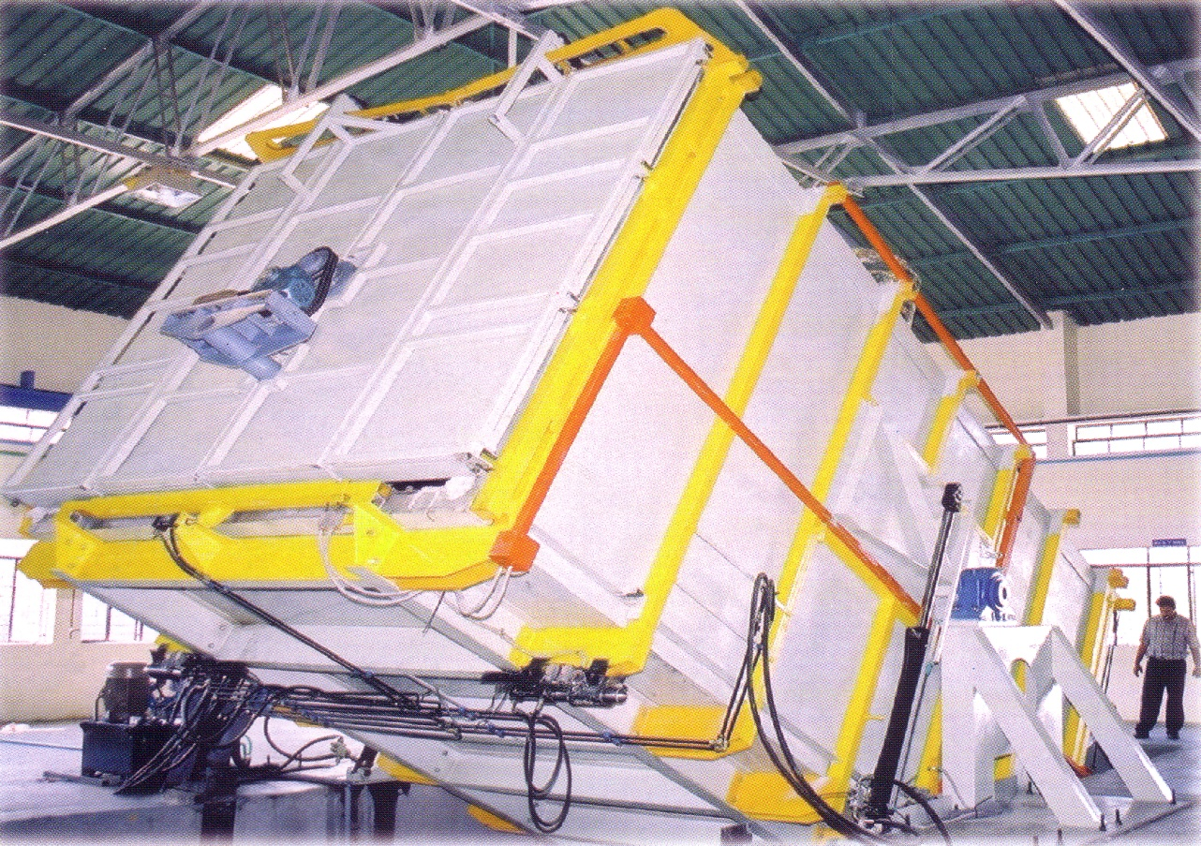
Rotational moulding
Rotation partly with the heating chamber

Slide 40
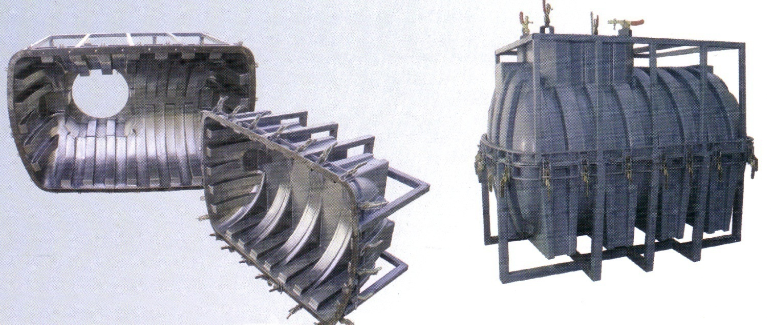
Rotational moulding
Rotational mould:
Mould materials:
Steel
Al

Slide 41
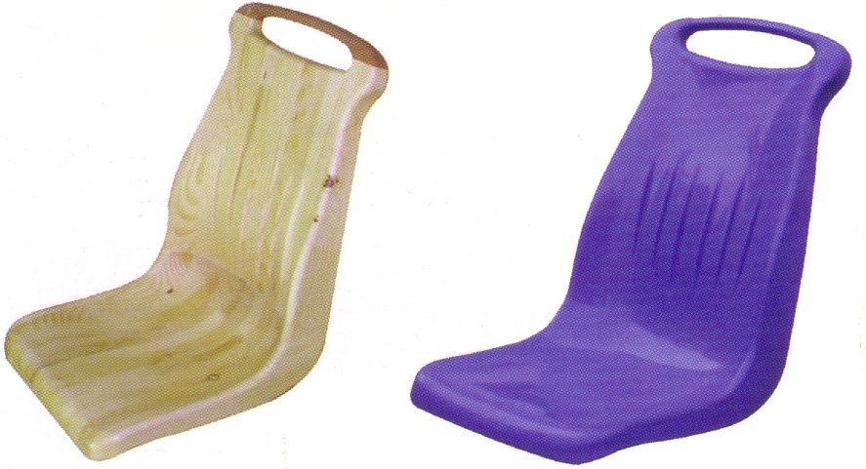
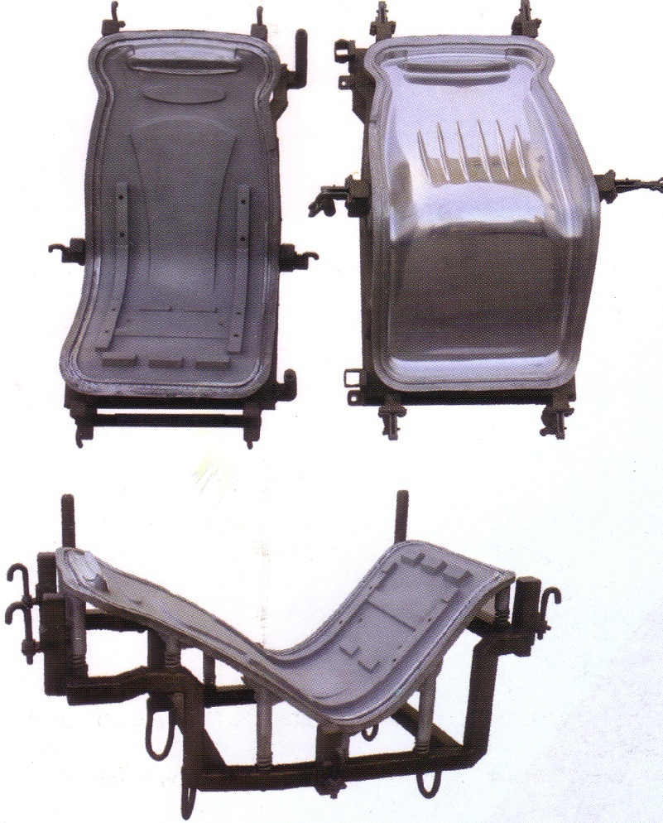
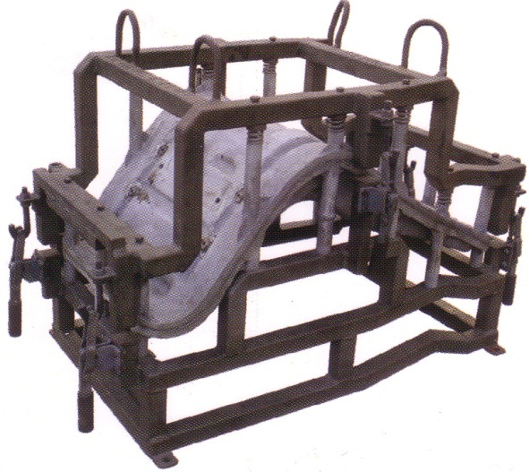
Rotational moulding
Rotational mould – cast Al:

Slide 42

Rotational moulding

Slide 43
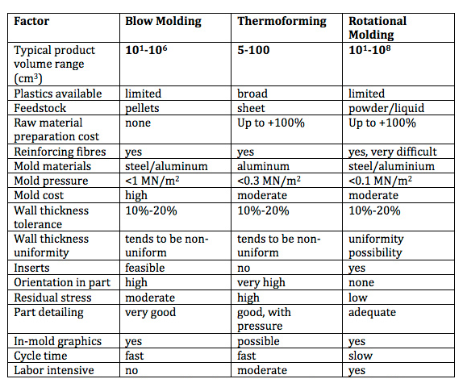
Rotational moulding

Slide 44
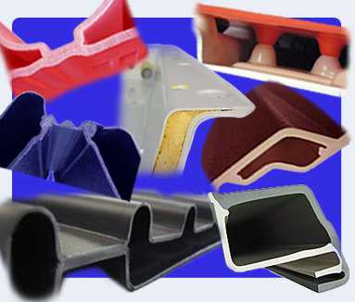
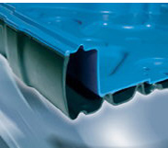
Twin-sheet thermoforming
Based on the thermoforming technique: Two preforms (sheets) are formed simultaneously in the lower and the upper moulds and in the meantime the two halves (sheets during forming) are welded together with proper pressure
Mainly for large, flat, stiff, light products with different side colours or different materials (must be compatible)

Slide 45
Twin-sheet thermoforming

Slide 46
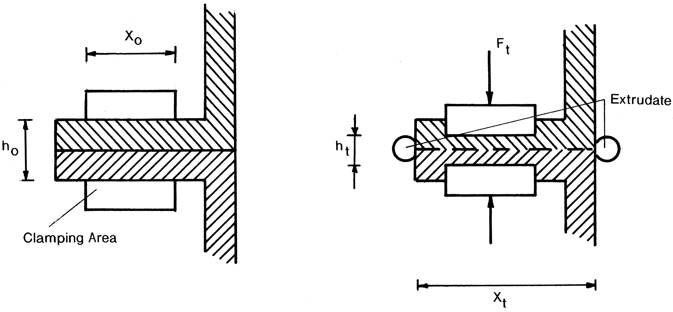
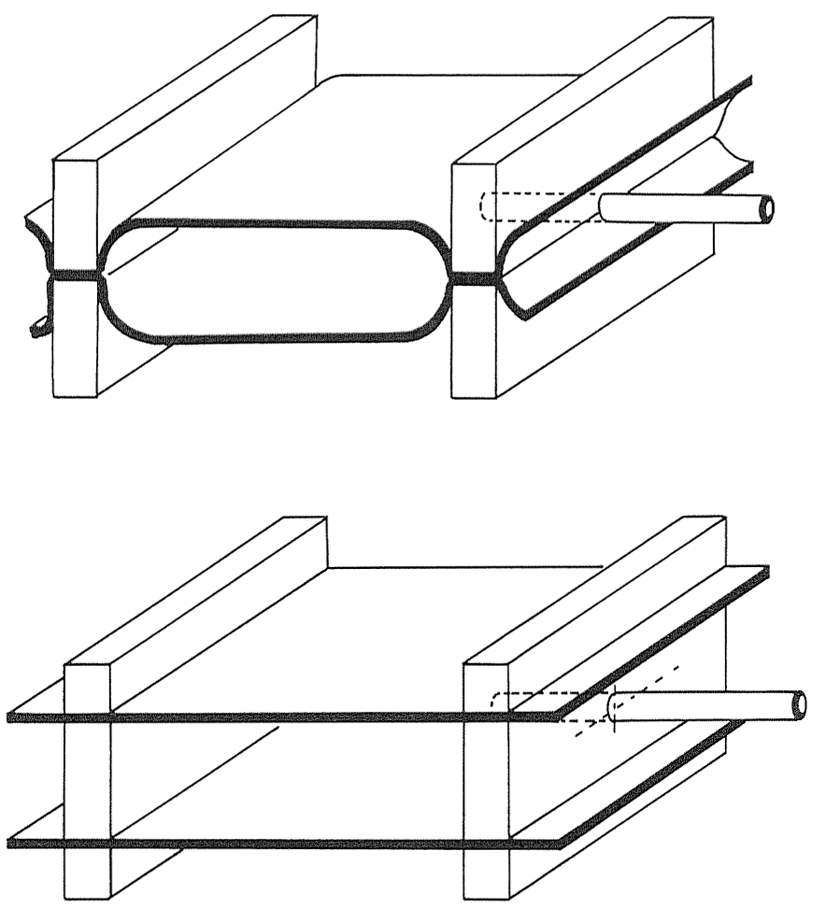
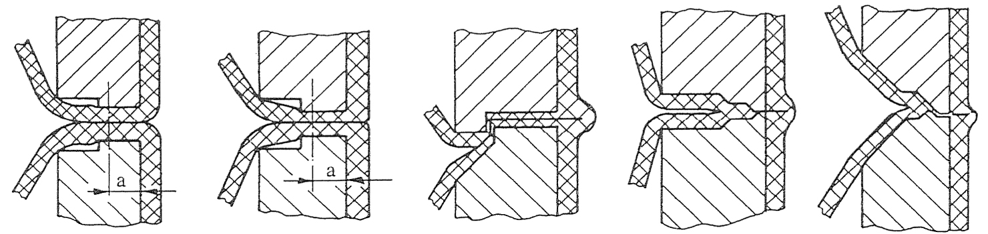
Twin-sheet thermoforming

Slide 47
Thank you for your attention!

Slide 48
References
References:
J.R. Wagner Jr., E.M. Mount III, H.F. Giles Jr.: PDL Handbook Series, Extrusion: The Definitive Processing Guide and Handbook. Elsevier Inc., Oxford, 2014
D.V. Rosato, A.V. Rosato, D.P. DiMattia: Blow Molding Handbook. Hanser, Munich, 2004
G.L. Beall, J.L. Throne: Hollow Plastic Parts: Design and Manufacture. Hanser, Munich, 2004
C. Rauwendaal: Polymer Mixing: A Self-Study Guide. Hanser, Munich, 1998
J.L White, A.Y. Coran, A. Moet: Polymer Mixing: Technology and Engineering. Hanser, Munich, 2001
J.L. Throne: Technology of Thermoforming. Hanser, Munich, 1996
P. Schwarzmann: Thermoforming: A Practical Guide. Hanser, Munich, 2001
W. Michaeli: Plastic Processes: An Introduction. Hanser, Munich, 1995
C. A. Harper: Handbook of Plastic Processes. Wiley-Interscience, Hoboken, New Jersey, 2006

